Slide 1
Introduction
Probability

Slide 2
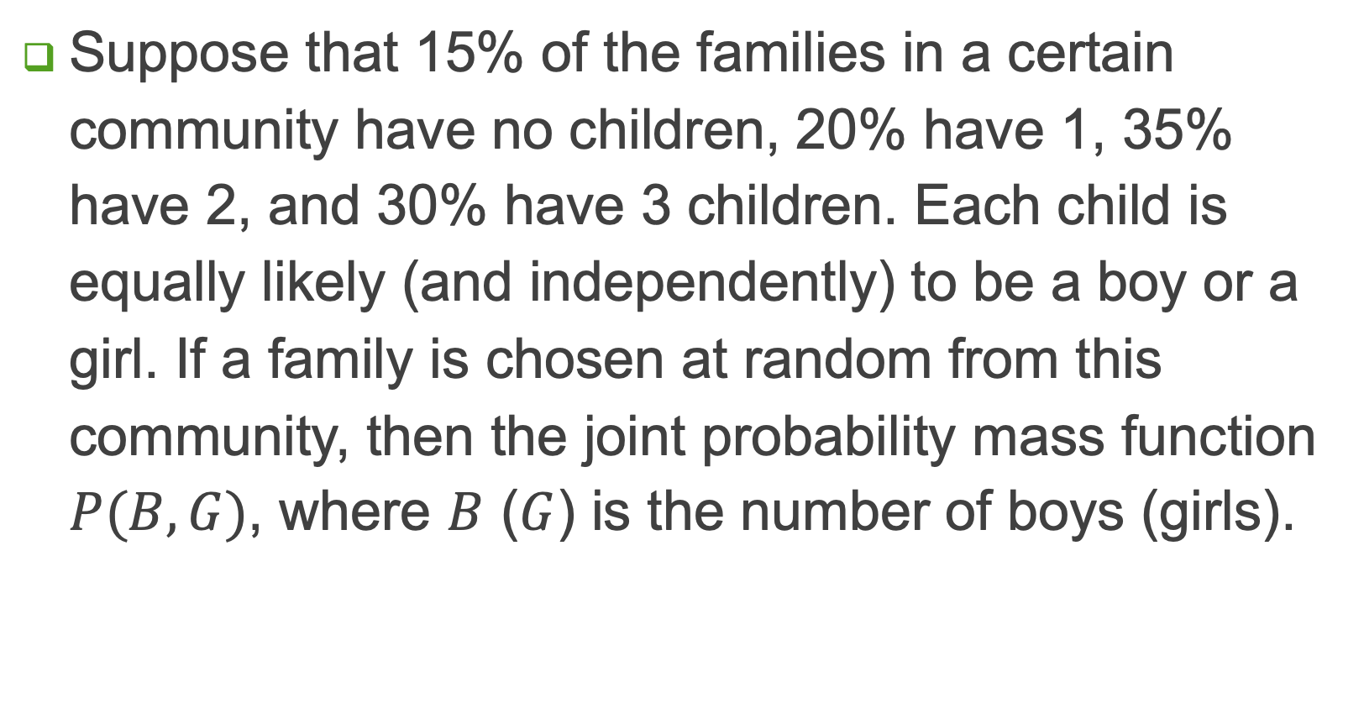
Example 1
Suppose that 15% of the families in a certain community have no children, 20% have 1, 35% have 2, and 30% have 3 children. Each child is equally likely (and independently) to be a boy or a girl. If a family is chosen at random from this community, then the joint probability mass function $P(B, G)$, where $B$ ($G$) is the number of boys (girls).

Slide 3
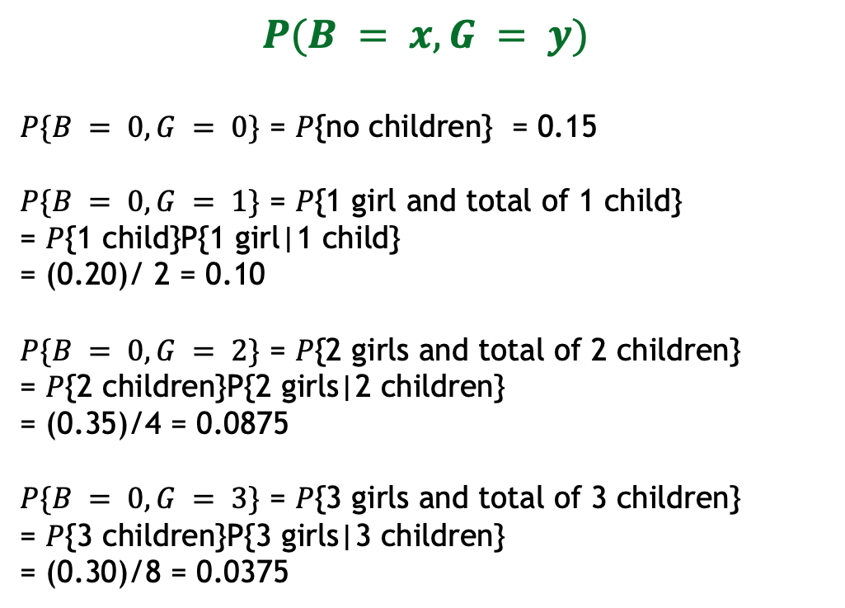
Joint Probability Distribution
Suppose that 15% of the families in a certain community have no children, 20% have 1, 35% have 2, and 30% have 3 children. Each child is equally likely (and independently) to be a boy or a girl. If a family is chosen at random from this community, then the joint probability mass function P(B, G), where B (G) is the number of boys (girls).
$$P(B = x, G = y)$$
$P\{B = 0,G = 0\}$ = $P${no children} = 0.15
$P\{B = 0,G = 1\}$ = $P${1 girl and total of 1 child}
= $P${1 child}P{1 girl|1 child}
= (0.20)/ 2 = 0.10
$P\{B = 0,G = 2\}$ = $P${2 girls and total of 2 children}
= $P${2 children}P{2 girls|2 children}
= (0.35)/4 = 0.0875
$P\{B = 0,G = 3\}$ = $P${3 girls and total of 3 children}
= $P${3 children}P{3 girls|3 children}
= (0.30)/8 = 0.0375

Slide 4

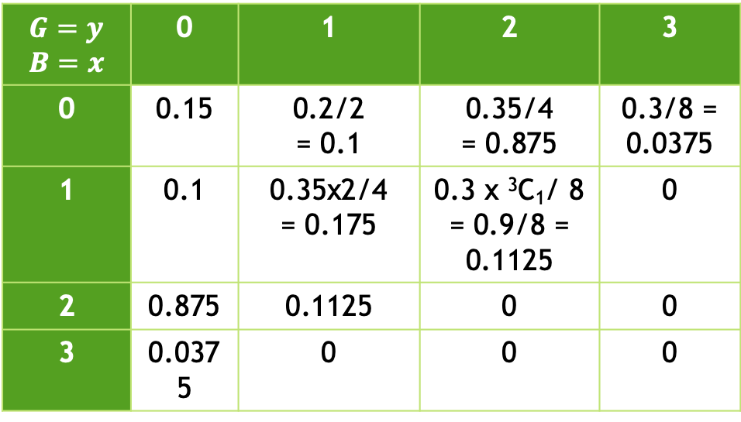
Joint Probability Distribution
Suppose that 15% of the families in a certain community have no children, 20% have 1, 35% have 2, and 30% have 3 children. Each child is equally likely (and independently) to be a boy or a girl. If a family is chosen at random from this community, then the joint probability mass function P(B, G), where B (G) is the number of boys (girls).
$$P(B = x, G = y)$$
$$G=y$$ $$B=x$$ | 0 | 1 | 2 | 3
0 | 0.15 | 0.2/2 = 0.1 | 0.35/4 = 0.875 | 0.3/8 = 0.0375
1 | 0.1 | 0.35x2/4 = 0.175 | 0.3 x ³C₁/ 8 = 0.9/8 = 0.1125 | 0
2 | 0.875 | 0.1125 | 0 | 0
3 | 0.0375 | 0 | 0 | 0

Slide 5

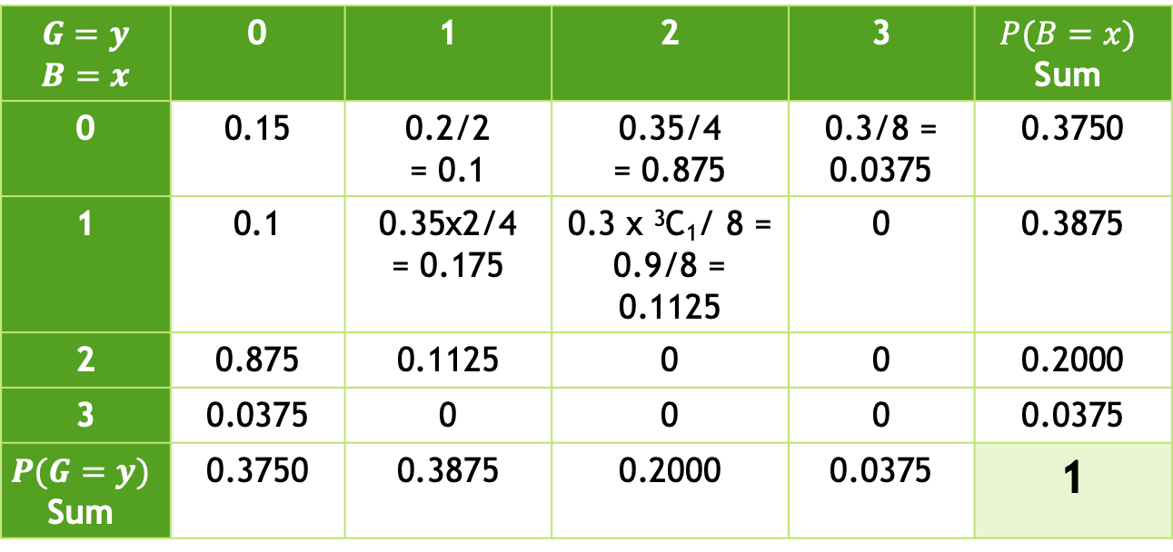
Joint Probability Distribution
Suppose that 15% of the families in a certain community have no children, 20% have 1, 35% have 2, and 30% have 3 children. Each child is equally likely (and independently) to be a boy or a girl. If a family is chosen at random from this community, then the joint probability mass function P(B, G), where B (G) is the number of boys (girls).
$$P(B = x, G = y)$$
$$G=y$$ $$B=x$$ | 0 | 1 | 2 | 3 | $$P(B=x)$$ Sum
0 | 0.15 | 0.2/2 = 0.1 | 0.35/4 = 0.875 | 0.3/8 = 0.0375 | 0.3750
1 | 0.1 | 0.35x2/4 = 0.175 | 0.3 x ³C₁/ 8 = 0.9/8 = 0.1125 | 0 | 0.3875
2 | 0.875 | 0.1125 | 0 | 0 | 0.2000
3 | 0.0375 | 0 | 0 | 0 | 0.0375
$$P(G=y)$$ Sum | 0.3750 | 0.3875 | 0.2000 | 0.0375 | 1

Slide 6
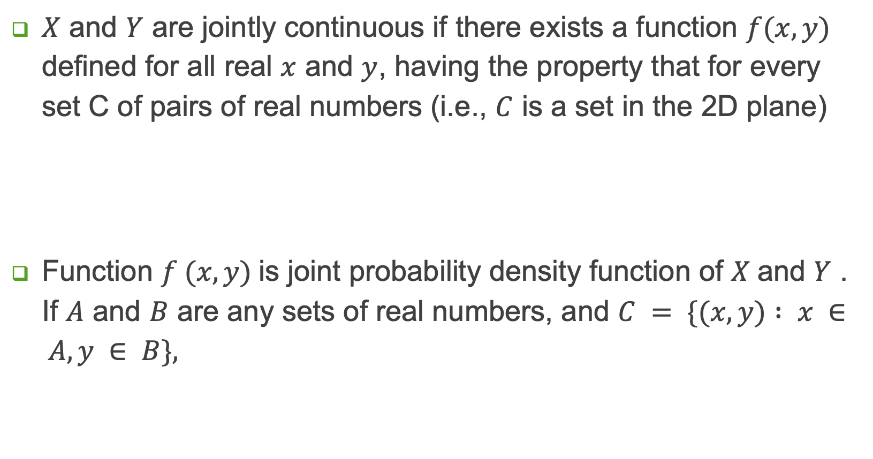
Joint Density Function
$X$ and $Y$ are jointly continuous if there exists a function $f(x, y)$ defined for all real $x$ and $y$, having the property that for every set C of pairs of real numbers (i.e., $C$ is a set in the 2D plane)
Function $f (x, y)$is joint probability density function of $X$and $Y$ . If $A$ and $B$ are any sets of real numbers, and $C = \{(x, y) : x ∈ A, y ∈ B\},$

Slide 7

Joint Density Function
Another interpretation of the joint density function
If $X$ and $Y$ are jointly continuous,
they are individually continuous,
With probability density functions

Slide 8

Example 2
Compute
$P\{X > 1, Y < 1\}$;
$P\{X < Y \}$; and
$P\{X < a\}$.
The joint density function of X and Y is given by

Slide 9
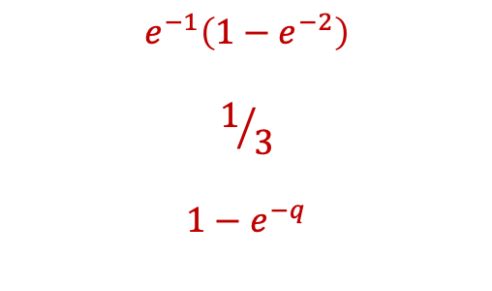
Example 2
Compute
P{X > 1, Y < 1};
P{X < Y }; and
P{X < a}.
The joint density function of X and Y is given by
$$e^{−1}\left(1−e^{−2}\right)$$
$$1/3$$
$$1−e^{−q}$$

Slide 10
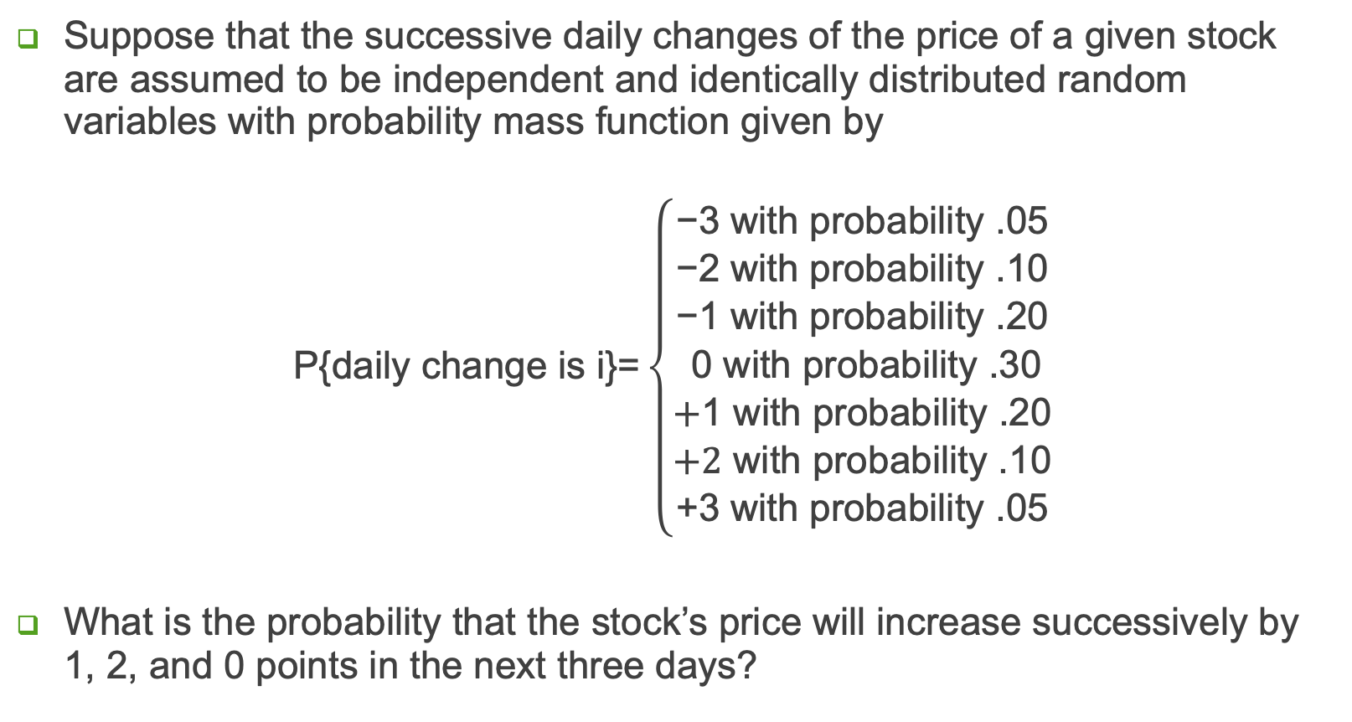
Example 3
Suppose that the successive daily changes of the price of a given stock are assumed to be independent and identically distributed random variables with probability mass function given by
$$\text{P}\text{\{}\text{daily} \text{change} \text{is} \text{i}\text{\}}\text{=}\left\{\begin{matrix}\begin{matrix}\text{−3 }\text{with} \text{probability}\text{ .05 } \\ \text{−}\text{2} \text{with} \text{probability}\text{ .}\text{1}\text{0 } \\ \text{−}\text{1} \text{with} \text{probability}\text{ .}\text{2}\text{0 }\end{matrix} \\ \text{0} \text{with} \text{probability}\text{ .}\text{3}\text{0 } \\ \begin{matrix}\text{+}\text{1} \text{with} \text{probability}\text{ .}\text{2}\text{0 } \\ \text{+2} \text{with} \text{probability}\text{ .}\text{1}\text{0 } \\ \text{+}\text{3 }\text{with} \text{probability}\text{ .05 }\end{matrix}\end{matrix}\right.$$
What is the probability that the stock’s price will increase successively by 1, 2, and 0 points in the next three days?

Slide 11
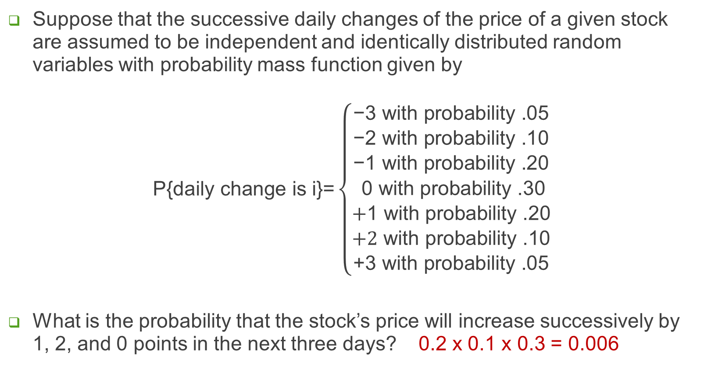
Example 3
Suppose that the successive daily changes of the price of a given stock are assumed to be independent and identically distributed random variables with probability mass function given by
$$\text{P}\text{\{}\text{daily} \text{change} \text{is} \text{i}\text{\}}\text{=}\left\{\begin{matrix}\begin{matrix}\text{−3 }\text{with} \text{probability}\text{ .05 } \\ \text{−}\text{2} \text{with} \text{probability}\text{ .}\text{1}\text{0 } \\ \text{−}\text{1} \text{with} \text{probability}\text{ .}\text{2}\text{0 }\end{matrix} \\ \text{0} \text{with} \text{probability}\text{ .}\text{3}\text{0 } \\ \begin{matrix}\text{+}\text{1} \text{with} \text{probability}\text{ .}\text{2}\text{0 } \\ \text{+2} \text{with} \text{probability}\text{ .}\text{1}\text{0 } \\ \text{+}\text{3 }\text{with} \text{probability}\text{ .05 }\end{matrix}\end{matrix}\right.$$
What is the probability that the stock’s price will increase successively by 1, 2, and 0 points in the next three days? 0.2 x 0.1 x 0.3 = 0.006

Slide 12
Conditional Distribution

Slide 13
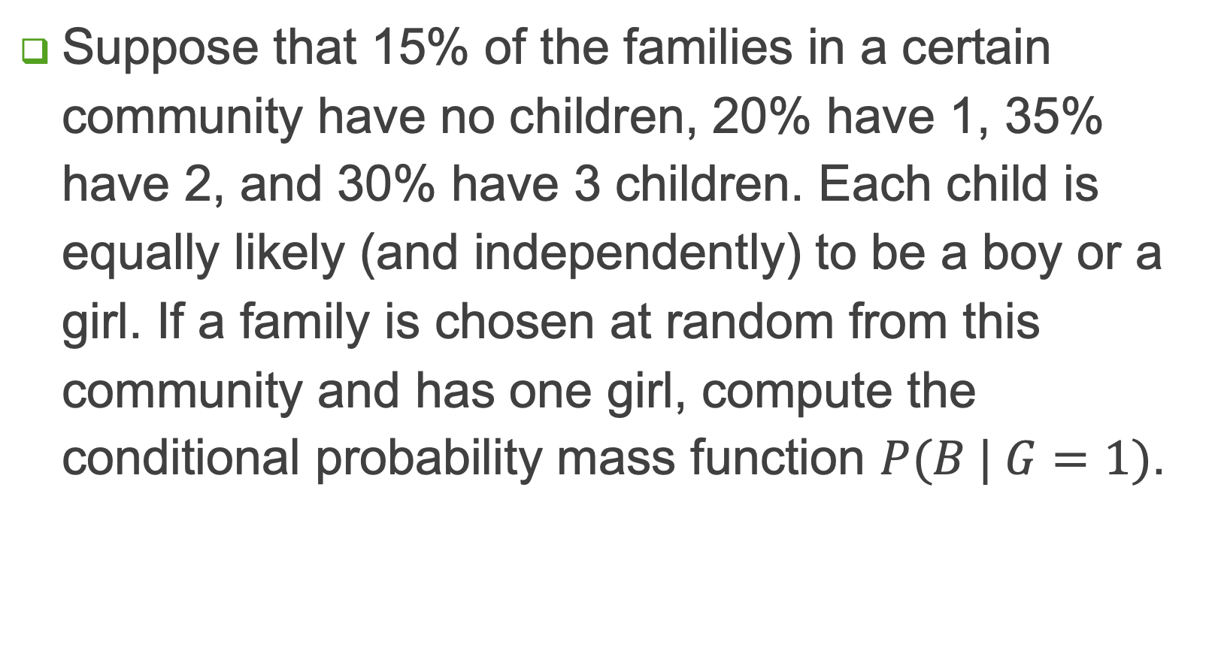
Example 4
Suppose that 15% of the families in a certain community have no children, 20% have 1, 35% have 2, and 30% have 3 children. Each child is equally likely (and independently) to be a boy or a girl. If a family is chosen at random from this community and has one girl, compute the conditional probability mass function $P(B | G=1)$.

Slide 14
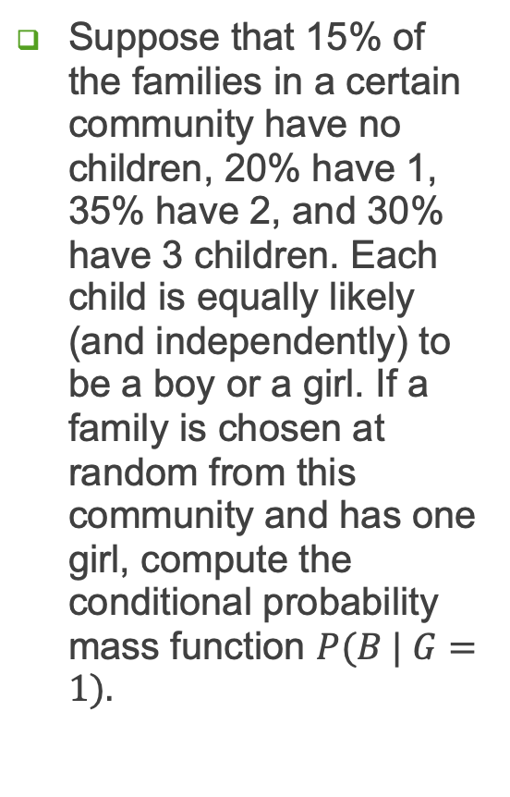
Example 4
Suppose that 15% of the families in a certain community have no children, 20% have 1, 35% have 2, and 30% have 3 children. Each child is equally likely (and independently) to be a boy or a girl. If a family is chosen at random from this community and has one girl, compute the conditional probability mass function $P(B | G=1).$
$$P(B = x, G = y)$$
G=y B=x | 0 | 1 | 2 | 3 | P(B=x) Sum
0 | 0.15 | 0.2/2 = 0.1 | 0.35/4 = 0.875 | 0.3/8 = 0.0375 | 0.3750
1 | 0.1 | 0.35x2/4 = 0.175 | 0.3 x ³C₁/ 8 = 0.9/8 = 0.1125 | 0 | 0.3875
2 | 0.875 | 0.1125 | 0 | 0 | 0.2000
3 | 0.0375 | 0 | 0 | 0 | 0.0375
P(G=y) Sum | 0.3750 | 0.3875 | 0.2000 | 0.0375 | 1
$$P(B = x|G = 1) = P(B=x, G=1)/P(G=1)$$

Slide 15

Example 4
Suppose that 15% of the families in a certain community have no children, 20% have 1, 35% have 2, and 30% have 3 children. Each child is equally likely (and independently) to be a boy or a girl. If a family is chosen at random from this community and has one girl, compute the conditional probability mass function $P(B | G=1).$
$$P(B = x | G = 1)$$
G=y B=x | 1
0 | 0.1/0,3875 = 8/31
1 | 0.175/0.3875 = 14/31
2 | 0.1125/0.3875 = 9/31
3 | 0
 | 1
$$P(B = x|G = 1) = P(B=x, G=1)/P(G=1)$$

Slide 16
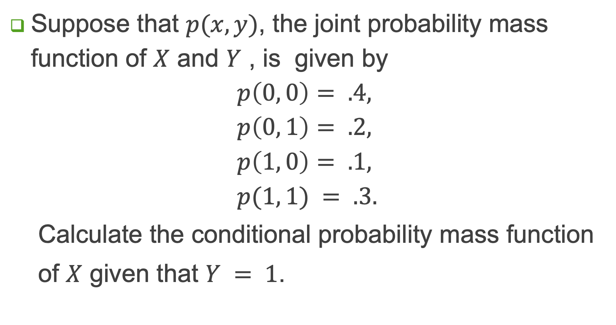
Example 5
Suppose that $p(x, y)$, the joint probability mass function of $X$ and $Y$ , is given by
$$p\left(0, 0\right)= .4,$$
$$p\left(0, 1\right)= .2,$$
$$p\left(1, 0\right)= .1,$$
$$p(1, 1) = .3.$$
Calculate the conditional probability mass function
of $X$ given that $Y = 1$.

Slide 17
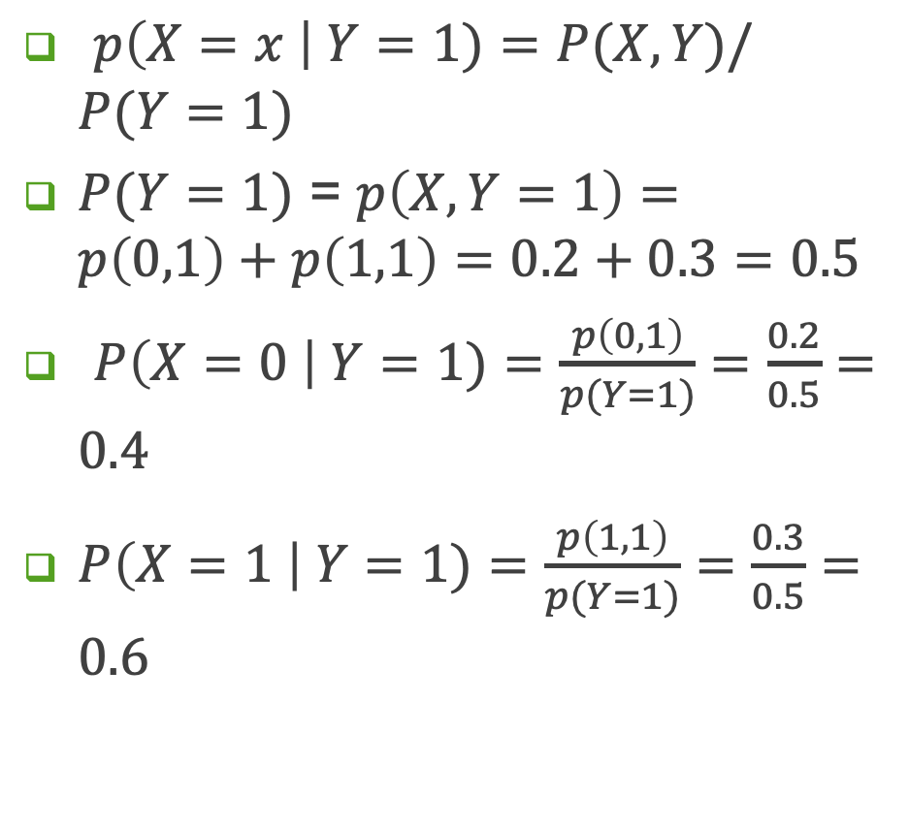
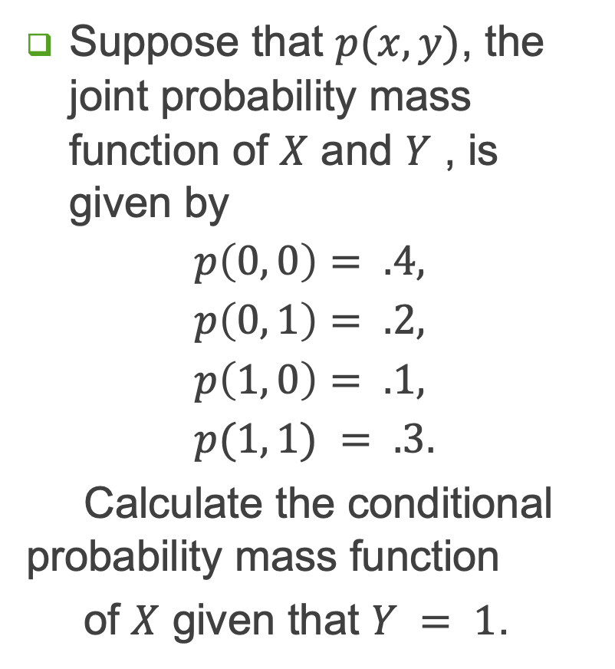
Example 5
Suppose that $p(x, y)$, the joint probability mass function of $X$ and $Y$ , is given by
$$p\left(0, 0\right)= .4,$$
$$p\left(0, 1\right)= .2,$$
$$p\left(1, 0\right)= .1,$$
$$p(1, 1) = .3.$$
Calculate the conditional probability mass function
of $X$ given that $Y = 1$.
$p\left(X=x \right| Y=1)=P(X,Y)/P(Y=1)$
$P(Y=1)$ = $p\left(X, Y=1\right)=p\left(0,1\right)+p\left(1,1\right)=0.2+0.3=0.5$
$P\left(X=0 \right| Y=1)=\frac{p\left(0,1\right)}{p(Y=1)}=\frac{0.2}{0.5}=0.4$
$P\left(X=1 \right| Y=1)=\frac{p\left(1,1\right)}{p(Y=1)}=\frac{0.3}{0.5}=0.6$

Slide 18
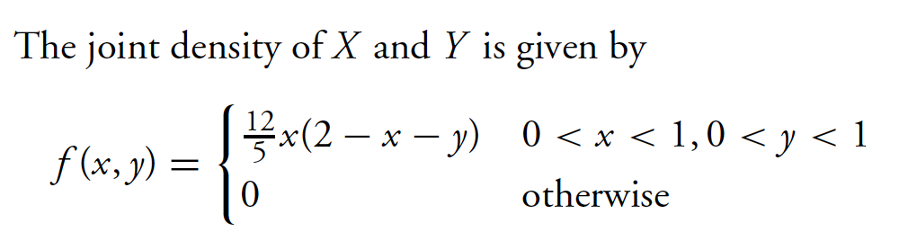
Example 6

Slide 19
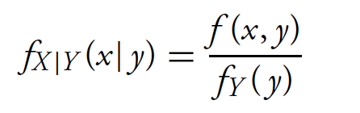
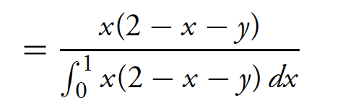
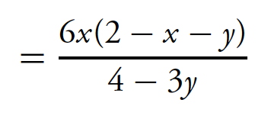
Example 6

Slide 20
Example 7
$X$ is a discrete random variable with $PX(k)=1/5$ for $k = −1, 0, 1, 2, 3$. If $Y=2\left|X\right|,$ find the range and PMF of $Y$.

Slide 21
Example 7
$X$ is a discrete random variable with $PX(k)=1/5$ for $k = −1, 0, 1, 2, 3$. If $Y=2\left|X\right|,$ find the range and PMF of $Y$.
Range: {0, 2, 4, 6}
$PY\left(0\right)=PX\left(0\right)=1/5$
$PY\left(2\right)=PX\left(−1\right)+PX\left(1\right)=2/5$
$PY\left(4\right)=PX\left(2\right)=1/5$
$PY\left(6\right)=PX\left(3\right)=1/5$

Slide 22
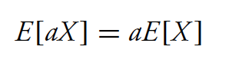




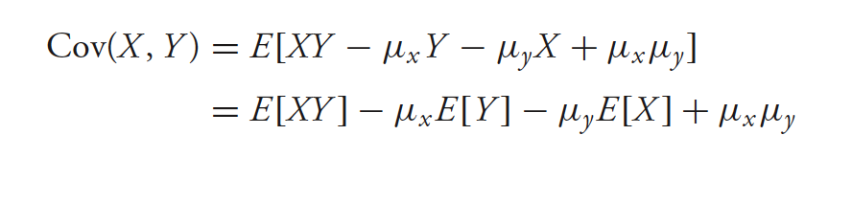
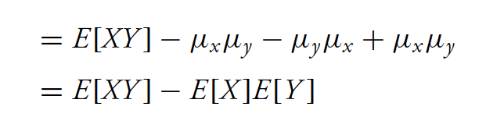
Expected Value: Properties

Slide 23
Example 8
Let $X$ be a discrete random variable with range $RX=\{0,\frac{π}{4},\frac{π}{2},\frac{3π}{4},π\}$such that $PX(0)=PX\left(\frac{π}{4}\right)=PX\left(\frac{π}{2}\right)=PX\left(\frac{3π}{4}\right)=PX(π)=1/5$. Find $E[sin⁡(X)]$.

Slide 24
Example 8
Let $X$ be a discrete random variable with range $RX=\{0,\frac{π}{4},\frac{π}{2},\frac{3π}{4},π\}$such that $PX(0)=PX\left(\frac{π}{4}\right)=PX\left(\frac{π}{2}\right)=PX\left(\frac{3π}{4}\right)=PX(π)=1/5$. Find $E[sin⁡(X)]$.
$E[sin⁡(X)]$ = $PX(0)$ $sin⁡(0)$+ $PX\left(\frac{π}{4}\right)$ $sin\left(\frac{π}{4}\right){+PX\left(\frac{π}{2}\right) sin\left(\frac{π}{2}\right){+PX\left(\frac{3π}{4}\right) sin\left(\frac{3π}{4}\right){+PX\left(π\right)\sin\left(π\right) ⁡}}}$
$E[sin⁡(X)]$ = $\frac{1}{5}\{$ $sin⁡(0)$+ $sin\left(\frac{π}{4}\right){+sin\left(\frac{π}{2}\right){+sin\left(\frac{3π}{4}\right){+\sin\left(π\right) \}⁡}}}$
$E[sin⁡(X)]$ = $\frac{1}{5}\{$0+0.707+1.0+0.707+0} = 2.414/5 = 0.483

Slide 25
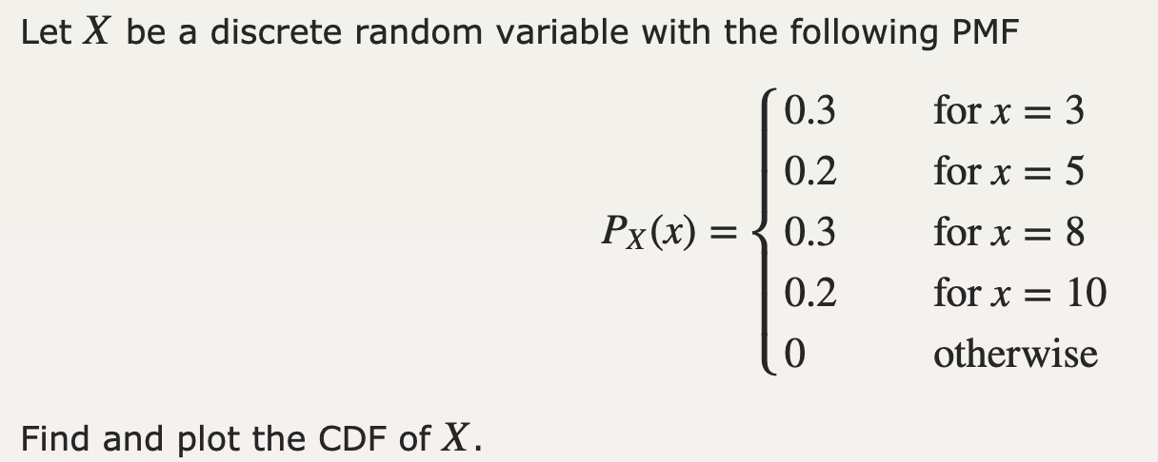
Exercise

Slide 26
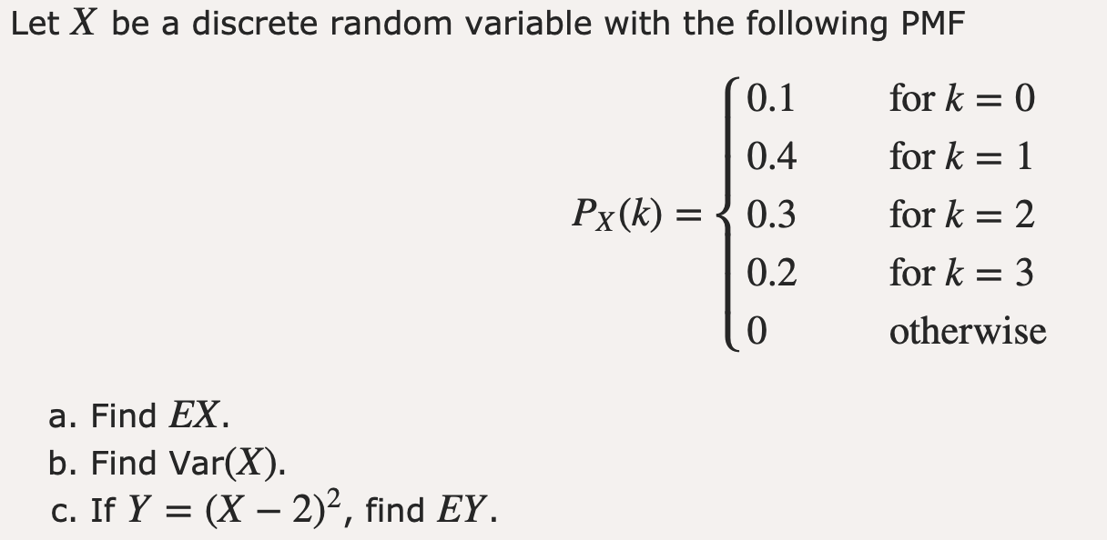
Exercise
$EX$ and $EY$ are expected values of $X$ and $Y$ respectively.

Slide 27
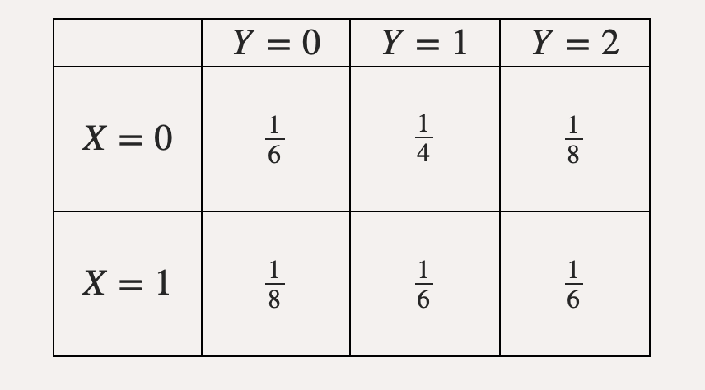
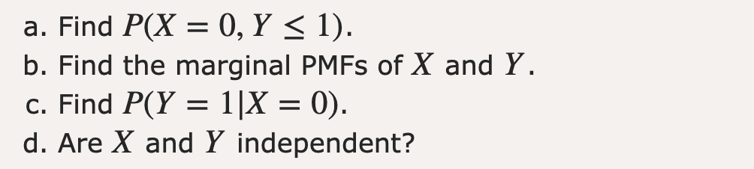
Exercise

Slide 28
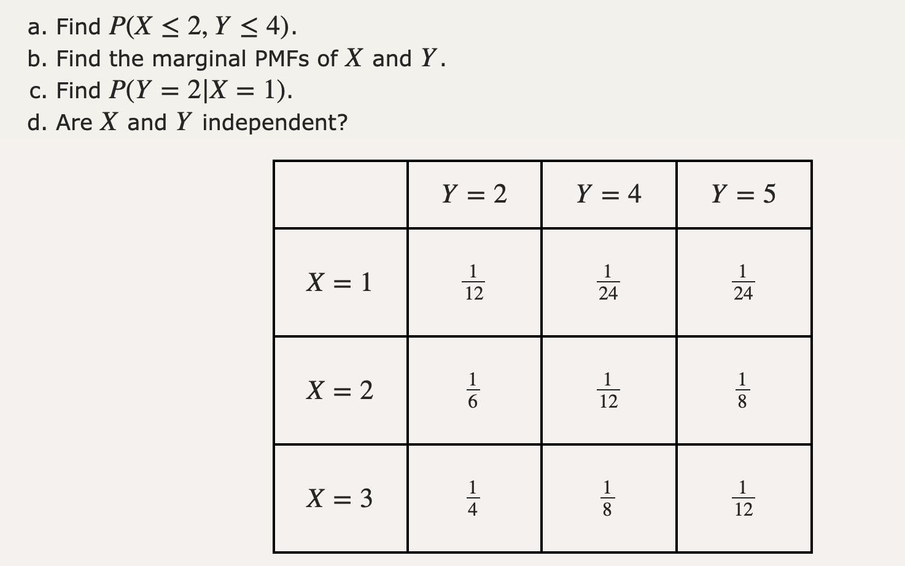
Exercise

Slide 29
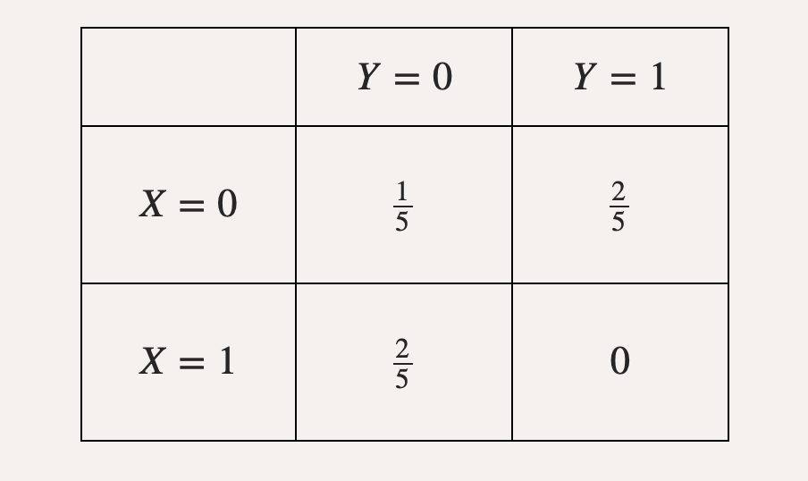
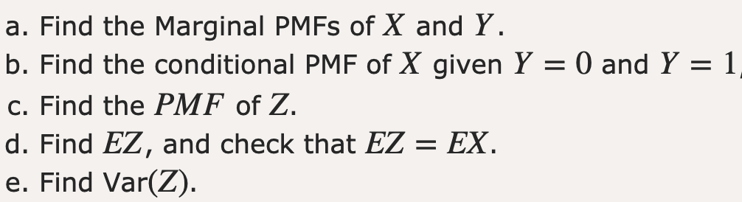
Exercise

Slide 30
Discrete Random Variable
Can have following mass functions
Bernoulli
Binomial
Geometric
Poisson
Negative Binomial Distribution

Slide 31
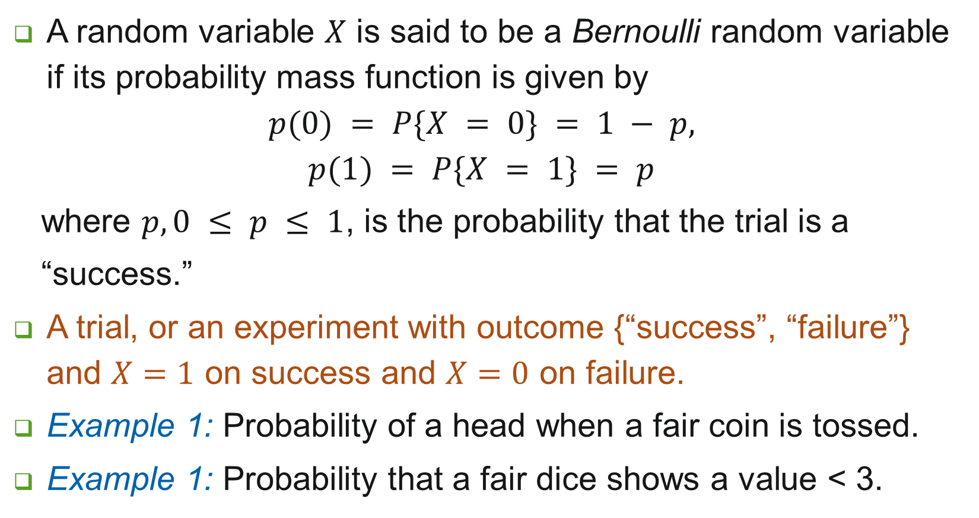
Bernoulli Random Variable
A random variable $X$ is said to be a Bernoulli random variable if its probability mass function is given by
$$p(0) = P\{X = 0\} = 1 − p,$$
$$p(1) = P\{X = 1\} = p$$
where $p, 0 ≤ p ≤ 1$, is the probability that the trial is a
“success.”
A trial, or an experiment with outcome {“success”, “failure”} and $X=1$ on success and $X=0$ on failure.
Example 1: Probability of a head when a fair coin is tossed.
Example 1: Probability that a fair dice shows a value < 3.

Slide 32
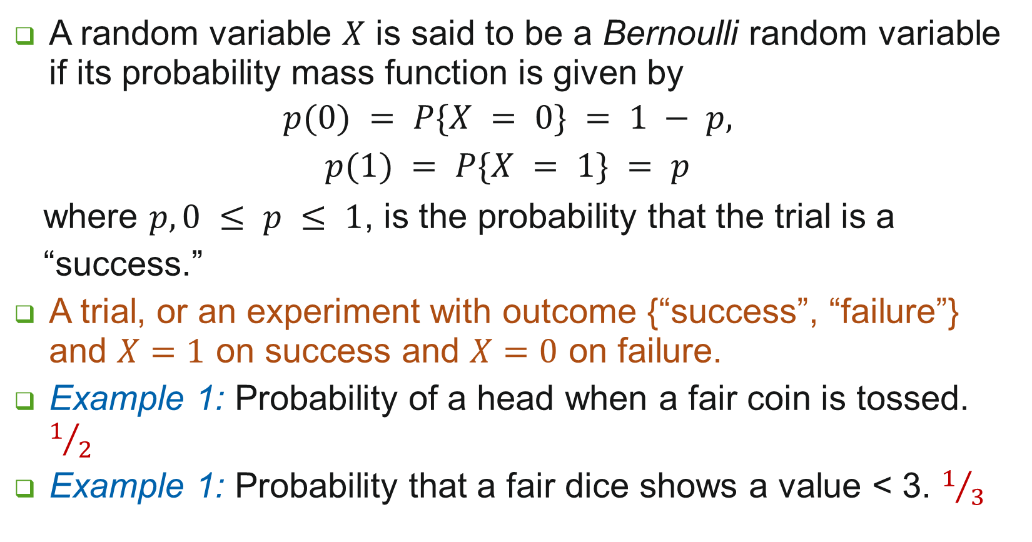
Bernoulli Random Variable
A random variable $X$ is said to be a Bernoulli random variable if its probability mass function is given by
$$p(0) = P\{X = 0\} = 1 − p,$$
$$p(1) = P\{X = 1\} = p$$
where $p, 0 ≤ p ≤ 1$, is the probability that the trial is a
“success.”
A trial, or an experiment with outcome {“success”, “failure”} and $X=1$ on success and $X=0$ on failure.
Example 1: Probability of a head when a fair coin is tossed. $1/2$
Example 1: Probability that a fair dice shows a value < 3. $1/3$

Slide 33
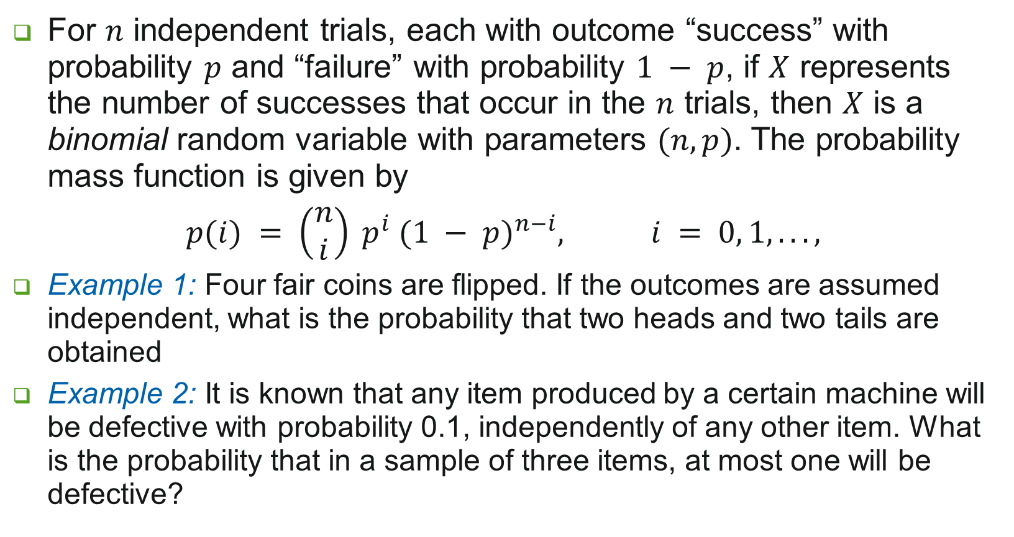
Binomial Random Variable
For $n$ independent trials, each with outcome “success” with probability $p$ and “failure” with probability $1 − p$, if $X$ represents the number of successes that occur in the $n$ trials, then $X$ is a binomial random variable with parameters $(n, p)$. The probability mass function is given by
$$p(i) = \left(\begin{matrix}n \\ i\end{matrix}\right) p^{i} {(1 − p)}^{n−i}, i = 0, 1, . . . ,$$
Example 1: Four fair coins are flipped. If the outcomes are assumed independent, what is the probability that two heads and two tails are obtained
Example 2: It is known that any item produced by a certain machine will be defective with probability 0.1, independently of any other item. What is the probability that in a sample of three items, at most one will be defective?

Slide 34
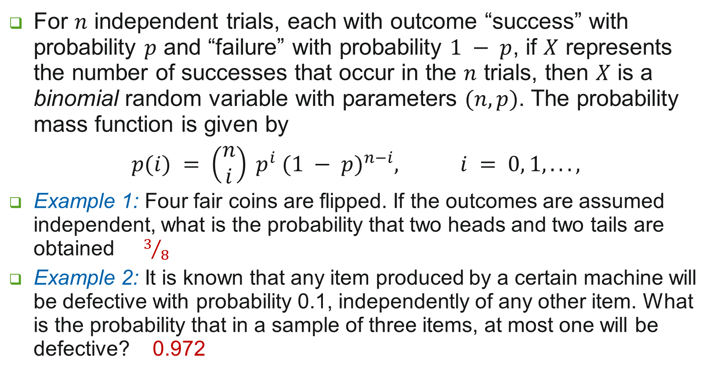
Binomial Random Variable
For $n$ independent trials, each with outcome “success” with probability $p$ and “failure” with probability $1 − p$, if $X$ represents the number of successes that occur in the $n$ trials, then $X$ is a binomial random variable with parameters $(n, p)$. The probability mass function is given by
$$p(i) = \left(\begin{matrix}n \\ i\end{matrix}\right) p^{i} {(1 − p)}^{n−i}, i = 0, 1, . . . ,$$
Example 1: Four fair coins are flipped. If the outcomes are assumed independent, what is the probability that two heads and two tails are obtained $3/8$
Example 2: It is known that any item produced by a certain machine will be defective with probability 0.1, independently of any other item. What is the probability that in a sample of three items, at most one will be defective? 0.972

Slide 35
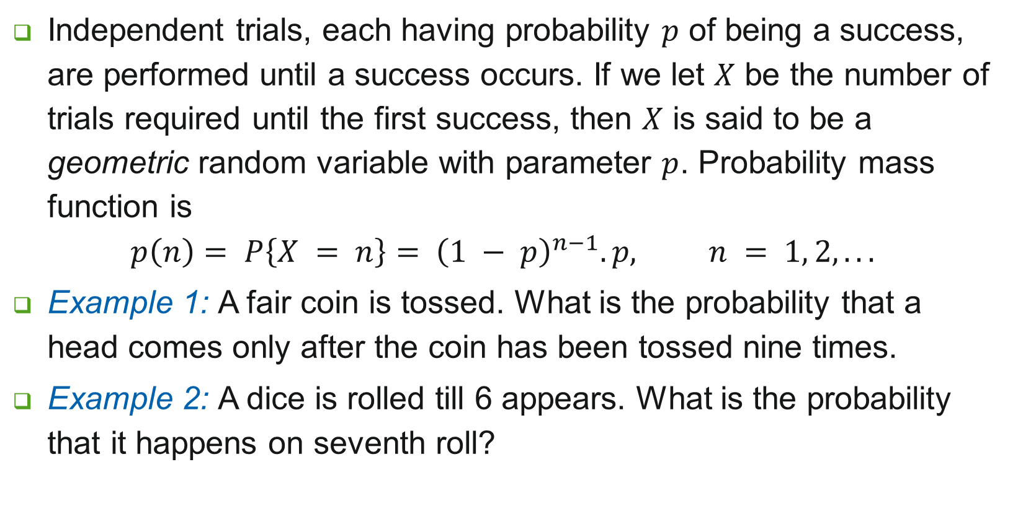
Geometric Random Variable
Independent trials, each having probability $p$ of being a success, are performed until a success occurs. If we let $X$ be the number of trials required until the first success, then $X$ is said to be a geometric random variable with parameter $p$. Probability mass function is
$$p\left(n\right)= P\left\{X = n\right\}= {\left(1 − p\right)}^{n−1}.p, n = 1, 2, . . .$$
Example 1: A fair coin is tossed. What is the probability that a head comes only after the coin has been tossed nine times.
Example 2: A dice is rolled till 6 appears. What is the probability that it happens on seventh roll?

Slide 36
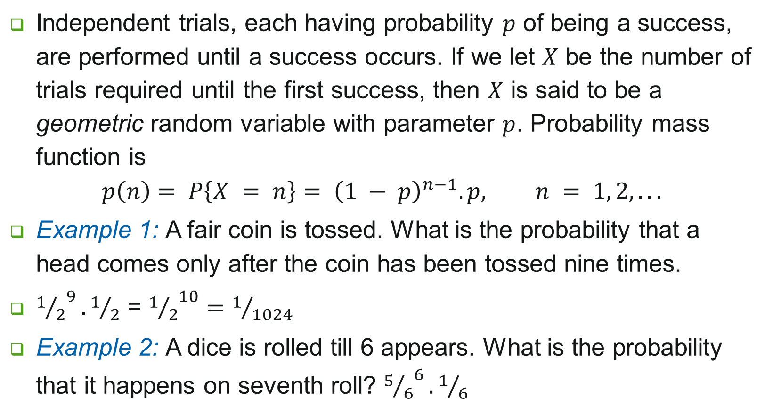
Geometric Random Variable
Independent trials, each having probability $p$ of being a success, are performed until a success occurs. If we let $X$ be the number of trials required until the first success, then $X$ is said to be a geometric random variable with parameter $p$. Probability mass function is
$$p\left(n\right)= P\left\{X = n\right\}= {\left(1 − p\right)}^{n−1}.p, n = 1, 2, . . .$$
Example 1: A fair coin is tossed. What is the probability that a head comes only after the coin has been tossed nine times.
${1/2}^{9}.1/2$ = ${1/2}^{10}=1/{1024}$
Example 2: A dice is rolled till 6 appears. What is the probability that it happens on seventh roll? ${5/6}^{6}.1/6$

Slide 37
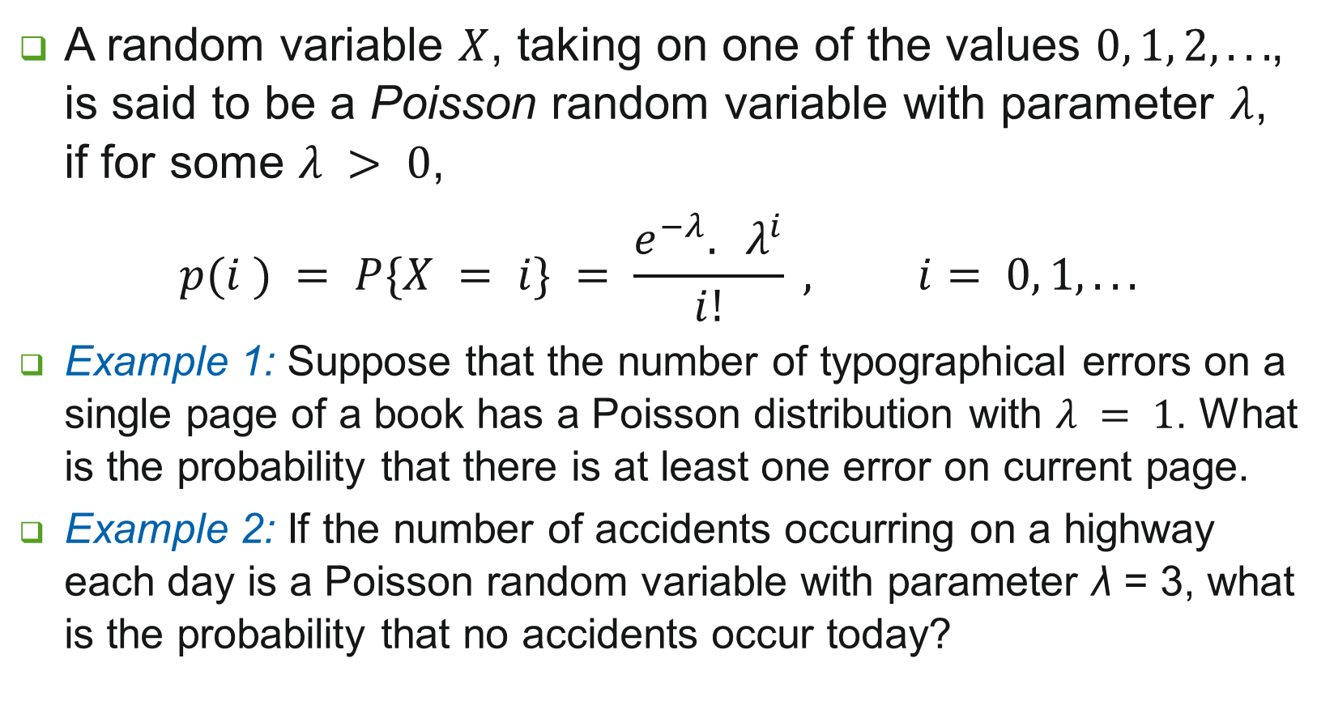
Poisson Random Variable
A random variable $X$, taking on one of the values $0, 1, 2, . . .$, is said to be a Poisson random variable with parameter $λ$, if for some $λ > 0$,
$$p(i ) = P\{X = i\} = \frac{e^{−λ}. λ^{i}}{i!} , i= 0, 1, . . .$$
Example 1: Suppose that the number of typographical errors on a single page of a book has a Poisson distribution with $λ = 1$. What is the probability that there is at least one error on current page.
Example 2: If the number of accidents occurring on a highway each day is a Poisson random variable with parameter λ = 3, what is the probability that no accidents occur today?

Slide 38
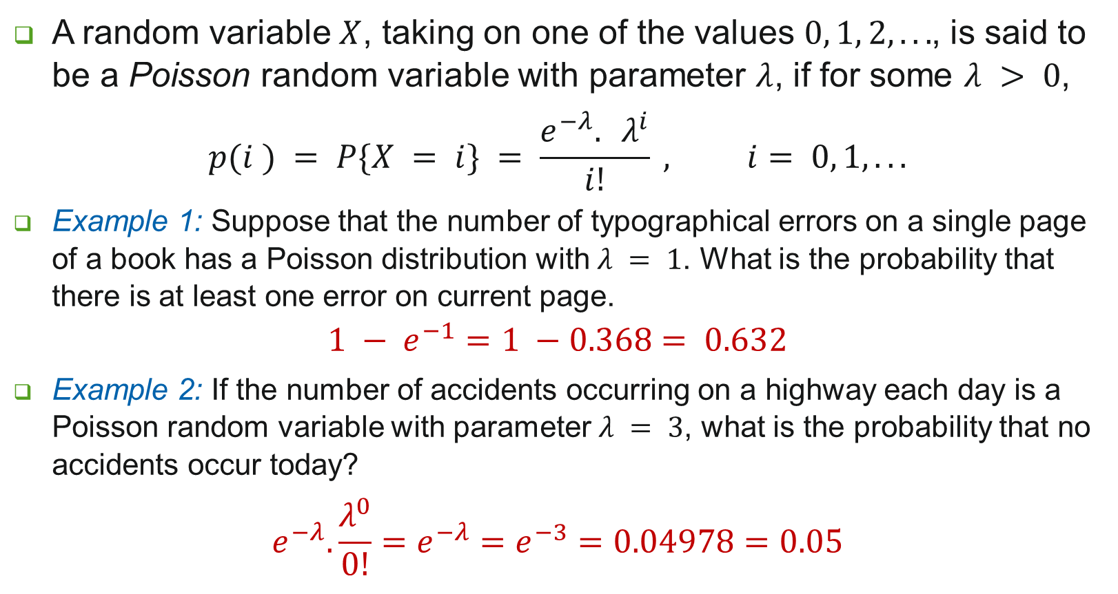
Poisson Random Variable
A random variable $X$, taking on one of the values $0, 1, 2, . . .$, is said to be a Poisson random variable with parameter $λ$, if for some $λ > 0$,
$$p(i ) = P\{X = i\} = \frac{e^{−λ}. λ^{i}}{i!} , i= 0, 1, . . .$$
Example 1: Suppose that the number of typographical errors on a single page of a book has a Poisson distribution with $λ = 1$. What is the probability that there is at least one error on current page.
$$1 − e^{−1}=1 −0.368= 0.632$$
Example 2: If the number of accidents occurring on a highway each day is a Poisson random variable with parameter $λ = 3$, what is the probability that no accidents occur today?
$$e^{−λ}.\frac{λ^{0}}{0!}=e^{−λ}=e^{−3}=0.04978=0.05$$

Slide 39
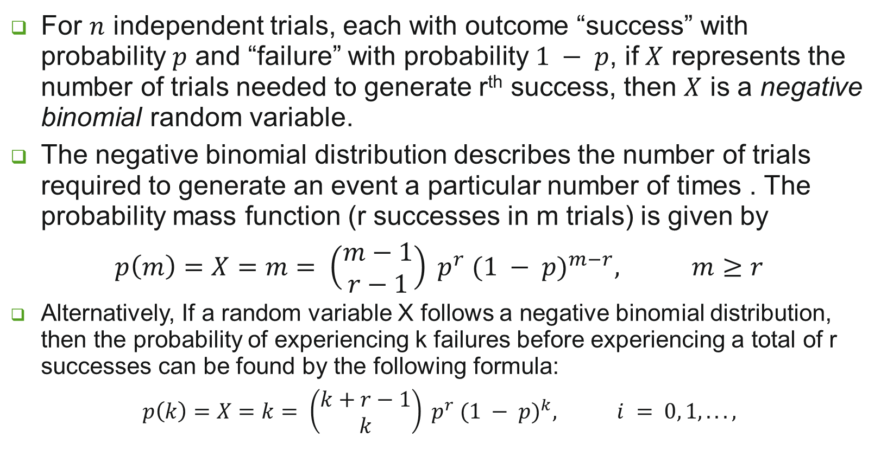
Negative Binomial Random Variable
For $n$ independent trials, each with outcome “success” with probability $p$ and “failure” with probability $1 − p$, if $X$ represents the number of trials needed to generate r^{th} success, then $X$ is a negative binomial random variable.
The negative binomial distribution describes the number of trials required to generate an event a particular number of times . The probability mass function (r successes in m trials) is given by
$$p\left(m\right)=X=m= \left(\begin{matrix}m−1 \\ r−1\end{matrix}\right) p^{r} {(1 − p)}^{m−r}, m≥r$$
Alternatively, If a random variable X follows a negative binomial distribution, then the probability of experiencing k failures before experiencing a total of r successes can be found by the following formula:
$$p\left(k\right)=X=k= \left(\begin{matrix}k+r−1 \\ k\end{matrix}\right) p^{r} {(1 − p)}^{k}, i = 0, 1, . . . ,$$

Slide 40
Negative Binomial Random Variable
Rolling the 5th six on the 20th roll of a die?
Getting the 10th defective item on the 1000th item inspected?
Selecting the 10th woman as the 15th participant?

Slide 41
Exercise
A particular trait (eye color/left-handedness) of a person is decided by a pair of genes – d (dominant) and r (recessive) gene. A person with dd genes is dominant, one with rr is recessive, and one with rd is hybrid (appearance is same as dominant). Children receive 1 gene from each parent. If, for a given trait, what is the probability that 3 of 4 children born of 2 hybrid parents have the outward appearance of the dominant gene?
The game, wheel of fortune (or chuck-a-luck), is played as follows. A player bets on one of the numbers 1 through 6. Three dice are then rolled, and if the number bet by the player appears times, , then the player wins units; if the number bet by the player does not appear on any of the dice, then the player loses 1 unit. Is this game fair to the player? Hint: Find expected value of wins.
Consider a jury trial in which atleast 8 of the 12 jurors should agree to convict the defendant. Jurors act independently and, each makes the right decision (defendant is guilty) with probability θ, what is the probability that the jury renders a correct decision (probability of defendant being guilty is α?

Slide 42
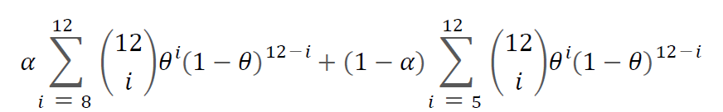
Exercise
A particular trait (eye color/left-handedness) of a person is decided by a pair of genes – d (dominant) and r (recessive) gene. A person with dd genes is dominant, one with rr is recessive, and one with rd is hybrid (appearance is same as dominant). Children receive 1 gene from each parent. If, for a given trait, what is the probability that 3 of 4 children born of 2 hybrid parents have the outward appearance of the dominant gene? [27/64]
The game, wheel of fortune (or chuck-a-luck), is played as follows. A player bets on one of the numbers 1 through 6. Three dice are then rolled, and if the number bet by the player appears times, , then the player wins units; if the number bet by the player does not appear on any of the dice, then the player loses 1 unit. Is this game fair to the player? Hint: Find expected value of wins. [ -17/236: Game is not fair to the player ]
Consider a jury trial in which atleast 8 of the 12 jurors should agree to convict the defendant. Jurors act independently and, each makes the right decision (defendant is guilty) with probability θ, what is the probability that the jury renders a correct decision (probability of defendant being guilty is α?

Slide 43
Thank you.

